Slide 1
Computer Principles for Programmers
Course Overview, Basics of File Systems and Visual Studio intro

Slide 2
Agenda
Lecture:
Instructor introduction
Goals of this course (what will you learn?)
Course Format and Evaluation (Weekly elements and Course Grading)
Steps for Success (Class Policies and Practices.)

Slide 3
Agenda (Cont’d)
Lecture:
What is a Drive? Folder/Directory? File? File Extension?
What are common File/Folders Operations?
Searching / Finding / Exploring the file system in Windows
Visual Studio introduction – the programming tool of professionals and the School of ICT
Notes:
Lecture:

Slide 4
Agenda (Cont’d)
Activity:
Visual Studio IDE programming demo in C
File naming and file extensions
Working with USB drive and/or local drive while doing common file and folder operations

Slide 5

Goals of this course
Computer Principles for Programmers offers global concepts in ICT.
C programming and Unix/Linux courses focus on detail level technical skills.
CP4P offers context for C & *nix skills in the business and ICT worlds.
UNIX Linux
CP4P CP4P
C pgmg
Notes:
Image from https://apod.nasa.gov/apod/ap000420.html
CP4P is the "big picture" course. We cover many things that the ICT industry expects programmers to be aware of and things that help you be a better programmer. IPC144 and ULI101 focus on detail level technical skills. This course hopes to help you put those skills in context within the business and ICT worlds.

Slide 6
Goals of this course
Professional programmers do more than just code.
Know concepts of Programming and Computer Systems
Practice productive habits and skills
Have facility with IDEs, different User Interfaces, Number Systems, File Compression, Backups, Versioning, Networks & Cloud Computing, Security, Project Management.
Know of Licensing, Regulations, Intellectual Property (IP).
Windows operating system (OS) is used as a template
Notes:
All programming students are also all professional programmers: you are paid, paid in marks, but paid nonetheless.
You do not need a personal Windows machine to be successful at Seneca. Our programs cover all major Operating Systems (IBM, *nix, Windows, with some Apple specific courses); Seneca labs give you access to all OS flavours. There will be times when it is necessary to work on the native OS.
There is a Visual Studio Code for Apple macOS but it is not the full Visual Studio IDE
It started life as Xamarin Studio – not Windows Visual Studio (VS) – so it is different from the VS used in the School of ICT C and C++ and C# programming courses.
It is a developer environment optimized for building mobile and cloud apps with Xamarin and .NET.
Visual Studio Code is available for macOS and Linux but it is an Editor whereas VS is an IDE
https://www.quora.com/Which-is-better-the-Visual-Studio-Community-2017-or-the-Visual-Studio-Code-2017
Apple macOS users: Create a VM that OS is windows, then install the Visual Studio Community and choose the option C++ to install during the VS installation
Macs are lovely and have certain vertical market advantages but are not generally used in business; Mac's North American PC market share is ~13% and ~7% worldwide (per Gartner and IDC research).
"If you just want a lightweight tool to edit your C++ files, VS Code has you covered but if you want the best possible experience for your existing Visual C++ projects or debugging on Windows, we recommend you use a version of Visual Studio such as Visual Studio Community." see https://code.visualstudio.com/docs/languages/cpp
https://social.msdn.microsoft.com/Forums/en-US/ef99e9f5-2a48-423b-b6c0-fa5617d7c63d/how-do-i-get-c-to-work-on-visual-studio-for-mac?forum=visualstudiogeneral
https://www.visualstudio.com/vs/visual-studio-mac/
https://www.visualstudio.com/en-us/productinfo/vs2017-compatibility-mac
https://docs.microsoft.com/en-us/dotnet/core/tutorials/using-on-mac-vs

Slide 7
Course Format and Evaluation
Quiz on previous week’s concepts
News of the Week
Weekly Lecture & Activity
Final Assignment – Groupwork

Slide 8
Weekly Quiz
Each class begins with a 15-minute quiz based on previous week's topic and activity.
Quizzes must be done on-time and in class to be marked.
Write 10 quizzes, the best 8 will count for course grading, 5% each.
If you are absent for a quiz for any reason, a mark of 0 will be assigned.
Notes:
You must begin the quiz during the first 15 minutes of class else you have missed the quiz.
You must sign the sign in sheet.

Slide 9
News of the Week
A 15-minute discussion on current news topics exposes ICT topics beyond the classroom.
Subscribe to a news service
Read what future employers read.
Come prepared to participate
Build your ICT vocabulary
Learn the TLAs (Three Letter Acronyms)
Notes:
ICT is Information and Communications Technology. It used to be just "I–T", Information Technology, until Communications became an essential part. E.g. How do you feel about using a computer or phone without an Internet connection?
ICT is a TLA. TLA is an in-joke: Three Letter Acronyms, There are lots of TLAs -- a few Two Letter Acronyms, but no FLAs -- Four Letter Acronyms, there are only xTLAs – eXtended Three Letter Acronyms (also an in-joke).
In 1988, in a paper titled "On the cruelty of really teaching computer science", eminent computer scientist Edsger W. Dijkstra wrote "Because no endeavour is respectable these days without a TLA ..."
When someone asks what does CPU, AI, USB, or RAM mean, you say, "It's a TLA." If anyone laughs, you know they are part of the ICT club. For the others who are frowning, you apologize for the ICT industry being full of TLAs, then explain TLA and the TLA itself—without using more TLAs.
The computer industry is obsessed with TLAs, mostly to impress and intimidate others.
http://www.nickh.org/computer/glossary.html

Slide 10
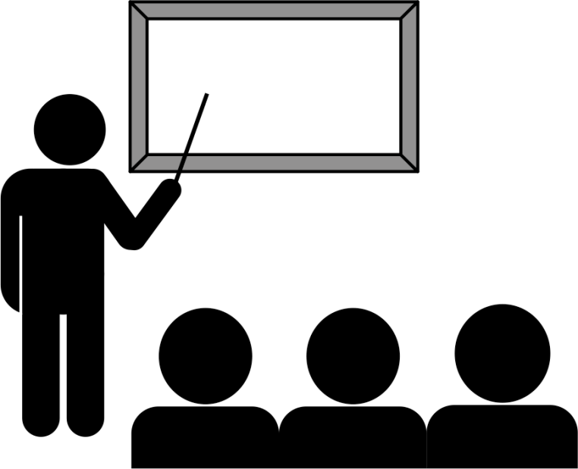
Weekly Lecture
Lectures deliver the content of the week's topic and activity which will become next week's quiz.
Ask questions during the lecture.
Put away your smartphone. (It makes you stupid.)
Be respectful of others.
Notes:
https://www.theglobeandmail.com/technology/your-smartphone-is-making-you-stupid/article37511900/
https://www.psychologytoday.com/blog/the-athletes-way/201706/are-smartphones-making-us-stupid
https://news.utexas.edu/2017/06/26/the-mere-presence-of-your-smartphone-reduces-brain-power
Dissenting opinion at https://www.thestar.com/opinion/star-columnists/2018/01/10/is-your-smartphone-making-you-stupid-dumb-question.html

Slide 11

Weekly Activity
Weekly Activity is your investigation of the week's topic
Activities can be done in class. Must be submitted by end of day to be marked.
Complete 11 activities, the best 9 will count for course grading, 4.44% each.
If you are absent for an activity for any reason, a mark of 0 will be assigned.

Slide 12

Final Assignment
Done in a group/team and must be completed to pass the course.
Worth 20% of total course marks
Completed during last 2 weeks of the term. Class time is team time.
No exam!

Slide 13

Graded Work
Content | %
Quizzes (8 of 10) | 40%
Activities (9 of 11) | 40%
Final Assignment | 20%
Total | 100%
Standards:
50+% overall to pass course per college policy. 50+% in each of Quizzes and Activities portions See Blackboard Course Information & Announcements for details

Slide 14

What steps you should take for success in this course — or any course?

Slide 15
Steps For Success…not goals, process.
Come to class.
Follow ICT tech news and come prepared to participate.
Take notes. ICT professionals do this in every meeting.
Thoroughly read all steps in the activity. TL;DR is not an option in the ICT business. They pay us to read manuals.
Discuss during the activity. Talking is part of learning.
Talk all you want but don't copy anything.
Come to class, every week. Focus on process, not goals.
Notes:
1. Come to class. Woody Allen said "80% of success is showing up."
3. Taking notes is not for recording the factoids of a lecture, it is for making meaning. What interests you? What do you want to look further into? What matters? Why does it matter? When will it matter?
…
5. "Talk all you want, don't copy anything." Giving or getting anything to/from another student that will be/has been graded is plagiarism, on both the giving and getting sides. In this course, that means quiz answers, activity submissions, and final assignment components. Please discuss anything and everything, just don't exchange quiz answers, activity doc files, program source code, or anything else that is marked by an instructor in any course.
6. Goals and dreams are great to have. Goals are what psychologists call Delayed Gratification: invest in short term pain for long term gain.
Your commitment to come to Seneca was huge. It will have long term value. Your goal to complete your program and learn good things gets you started. It is hard to start something so big, and yet, you’ve done that. That's a great goal but it isn't enough.
So why don’t goals work? Delayed Gratification takes too long, that’s why. Hard work often pays off after time, but laziness always pays off now. What works? Process works. Having a goal to do a marathon does not work. Diligent training and wearing out many pairs of running shoes…that works.
Process is planning your novels while on public transit – that works. Process is writing your novel in longhand whenever your baby daughter sleeps – that works. Keying it on a typewriter—repeatedly—works. The process of doing that for 5 years got the novel written. Spending a year being rejected by agents, then finding one who sent the manuscript to 12 publishers, who all rejected it, all the while training as a teacher in case the novel didn't sell…that works. The 13th publisher, Bloomsbury, agreed to take a chance on Harry Potter and the Philosopher’s Stone publishing it with low expectations. That’s how J.K. Rowling got the first Harry Potter book out into the world. Process got it written. Process got it published. But just having a goal to sell over 500 million books and become the richest author in history does not get it done. Success is about process; that's what Woody Allen meant by "showing up."
These and other details should be in each professor’s course Addendum.
Attend all classes and “be on time.”
“Silence” audible devices.
Don’t work on the activities or assignments during the lecture! Focus on the task at hand – “don’t multitask.”
Review previous lecture notes to prepare for the quiz of each week, “before class.”
Submit all graded work on time.
Even if you know some of the material already, we are going to emphasize the “professional practice” of those concepts. So, “be patient and pay attention all the time.”
“Keep quiet” during the quiz, news, and lecture and “don’t distract others.”
The ultimate goal is to get you ready for the job market. So, get in the habit of being “punctual and respectful of others.” Treat your professor as your boss/manager and treat your classmates as your colleagues.
During the quiz, looking at others monitors and/or talking before everyone is done is considered as “cheating.”
Check your grades and if you have any concern about them for each week, talk to your professor “no later that the following week.”
You are responsible to “continuously and regularly check and follow” your Seneca emails for this course. There might “always” be important messages!
Based on the emails your professor receives, it might take some time for him/her to reply your email; “be patient!”
If you miss a class, your professor is not going to re-teach that to you (even during office hours). You are responsible for your learning. Back each other up by taking / sharing notes (but NOT graded items).
Don’t rush on submitting the activities and leaving the class sooner; instead, “concentrate on studying the steps needed to be done and doing them right!” Also, there might be “some directions or explanations needed from your professor before doing the activities”. Therefore, even if you have thought about them before class, listen to your professor’s explanations and then, submit the activity of the week “in class.”
Quizzes and activities are to be done “in class, on-time, and through Blackboard.” You can’t email them or do them after the class or out of their time. Also, “be careful of your Blackboard submissions and double check everything” before that.
You have the right to ask help from your instructor or other students or search the web to find the answers to questions in the activities, but the “ultimate answers should be yours.”

Slide 16
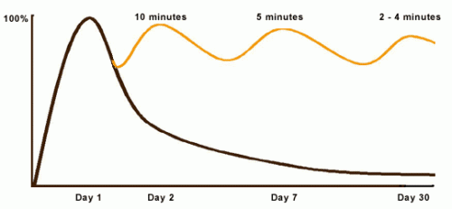
Curve of Forgetting
Review = Retention = Quiz marks
See U of Waterloo and Ebbinghaus
Notes:
https://www.google.ca/search?q=Ebbinghaus+forgetting+curve
https://uwaterloo.ca/campus-wellness/curve-forgetting
On day 1, at the beginning of the lecture, you go in knowing little of what might be said ( 0% baseline). At the end of the lecture you know 100% of what you know, however well you know it (where the curve rises to its highest point).
By day 2, if you have done nothing with the information you learned in that lecture, didn't think about it again or read it again, you may have lost 50%-80% of what you learned.
By day 7, we remember even less, and by day 30, we retain about 2%-3% of the original hour. It's pretty much gone…you know this. Have you ever wondered when taking a quiz or writing an exam, "Where did this question come from?"
You can change the shape of the curve! Reprocessing the same chunk of information sends a big signal to your brain to hold onto that data. When the same thing is repeated, your brain says, "Oh - there it is again, I better keep that." When you are exposed to the same information repeatedly, it takes less and less time to "activate" the information in your long term memory and it becomes easier for you to retrieve the information when you need it.
Here's the process:
after a good night's sleep and within 24 hours of getting the information, spend 10 minutes reviewing and you will raise the remembering curve to almost 100% again. A week later (Day 7), it takes 5 minutes to "reactivate" the same material and raise the curve back up. By Day 30, your brain will need 2-4 minutes of review to not only remember what you knew on Day 1 but will likely understand more than you did then. During the test, you'll think, "Hey, I know where that question came from…"
Often students feel they can't possibly make time for a review session every day in their schedules – students have trouble keeping up as it is. However, this review is a pro-active investment of less than one-half hour of your time. If you don't review, you will need to spend 40-50 minutes re-learning each hour of material later. So, if you don't have time now, exactly when are you going to have that kind of time in the future when things get even busier?

Slide 17
Our School of ICT has found…
In the beginning of the program, students vary widely in their computing "literacy" and overall programming abilities.
By the end of the program, there is little difference.
Humans naturally compare themselves to others: good for self-motivation but bad for self-evaluation/esteem. “Comparison is the thief of joy.” —Theodore Roosevelt
How did you learn to ride a bicycle? Not by falling off, but by getting up again.
Notes:
https://en.wikipedia.org/wiki/Social_comparison_theory
individuals evaluate their abilities by comparing themselves to others in order to reduce uncertainty in these domains, and learn how to define the self. (Festinger, 1954)
https://www.psychologytoday.com/basics/social-comparison-theory
http://www.cnn.com/2015/10/27/health/comparing-yourself-with-peers/index.html
Galinksy and Schweitzer (2015) write that "when it comes to using social comparison to boost your own motivation, here is the key rule to keep in mind: Seek favorable comparisons if you want to feel happier, and seek unfavorable comparisons if you want to push yourself harder."

Slide 18
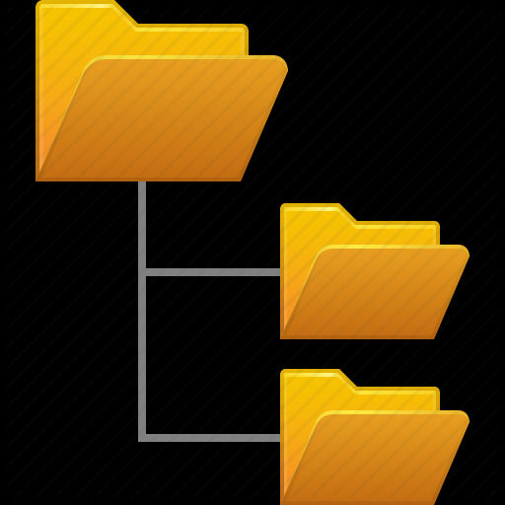
Drive, Folder/Directory and Files
Know ICT terminology and concepts so you can nod knowingly during a job interview.
Notes:
One objective in this course is conveying the terminology and concepts of ICT so you can nod knowingly during a job interview. Let's get started.

Slide 19
What is a Drive? …a storage device?
Drive: storage device recognized by an Operating System (OS)
OS mounts drives: recognizes hardware & assigns unique identifier C: or D: or E: or ... in Windows (mounting is automagic) # mount /dev/sdc1 /media/usb-drive/ in Linux/Unix -hardware- ---- identifier ----
Mounting is the process of making the file system on a storage device accessible to the OS and your applications/software.
Storage Device
hardware that saves data persistently (permanently)
Persistently…after the program ends or the power goes off.
Notes:
Automagic = as programmers, we know hardware and operating systems do things for us but we don't want to know how. Therefore, automagic.
When a new USB flash drive is plugged in, you will often see messages about installing a device driver or configuring it. That is Windows "mounting" the new storage device as a drive.
https://www.ibm.com/developerworks/library/l-lpic1-104-3/index.html

Slide 20
Drives use persistent storage devices
Types (and examples) of "persistent storage" devices:
Hard Disk Drive (internal, external, portable, NAS)
A motor drives a disk with platters coated in magnetic material.
Optical Disc (CD 700MB, DVD 4.7GB, BD 25GB)
a disk coated in reflective material is read/written by a laser
Solid State Drive (USB flash drive; 2.5",mSATA,M.2 form factors)
Integrated Circuits store data without mechanical moving parts.
Cloud Drive (iCloud, OneDrive, Dropbox, Google/Amazon Drive)
Internet+software makes the cloud look like a local drive to your OS.
Devices are attached to your "machine"
what IT people call their computers
Notes:
The term "drive" is often used when referring to "devices" because, in common usage, our users don't need to make (or even know of) the distinction. Plug it in and it works like a drive…and we don't want to explain any more than that.
Devices are attached to your "machine" (what IT people call their computers) as in Turing machine (1937) – a theoretical computer and as in "calculating machine" (1897) used by "computers", i.e. people who calculate (from the Latin 'computare', http://www.latin-dictionary.net/search/latin/computare)
https://books.google.ca/books?id=J4i3zV4vnBAC&pg=PA97&lpg=PA97&dq=Oxford+Dictionary+of+Word+Origins+computer&source=bl&ots=aFsbRKzNte&sig=YnDDkmw8zN7CEi4mo2AQ-kpLqEE&hl=en&sa=X&ved=0ahUKEwjMjcTMlMbYAhXB7YMKHeg7BaUQ6AEIbTAN#v=onepage&q=Oxford%20Dictionary%20of%20Word%20Origins%20computer&f=false
HDDs can be "internal" (for high performance on a data bus connected to a motherboard or disk controller) or outside the machine (via USB with lower performance but higher flexibility) …"external" drives tend to be large capacity units needing their own power supply or "portable" drives powered by the USB connection or by a network connection to a NAS – Network Attached Storage system. NAS devices range from industrial size units with multi-Gigabit to Terabit connections to a Western Digital "My Cloud" device plugged into your home router.
HDDs are "hard" versus Floppy Disk Drives used in the 1970s, 80s, and 90s. The term Floppy was invented to distinguish them from other disk systems with drives that, since 1956, had been only hard. The original "floppy" term was "diskette" – a little disk – but that 1971 term never got outside the computer room. The IBM PC, introduced in 1981, used FFDs like other microcomputers of the time. HDDs became affordable for personal computers in the mid to late 1980s. By that time, people were used to calling disks "floppys" so the term hard disk drive ( C: )came into use to distinguish them from floppy disk drives ( A: & B: ). What's old became new again.
Usually disk refers to magnetic storage, disc refers to optical storage.
CD – Compact Disc, originally developed for music distribution.
DVD – Digital Versatile Disc, originally used mostly for video distribution replacing VHS tape media, thus the Digital Video Disc confusion.
BD – Blu-ray Disc. 25GB blank BD-R discs are affordable. Given the costliness of 50 – 128GB BD-Rs, you might consider USB or even portable HDD drives.
You can no longer assume that everyone has a general purpose optical disc reader or, if they do, that it can read BD discs.
http://royal.pingdom.com/2010/02/18/amazing-facts-and-figures-about-the-evolution-of-hard-disk-drives/
https://en.wikipedia.org/wiki/Hard_disk_drive
https://en.wikipedia.org/wiki/Disk_read-and-write_head
Disk read/write heads on actuated arms move across the surface of a spinning disk platter transforming the platter's magnetic field into electrical current (read) or, vice versa, transforming electrical current into a field which changes the charge of the platter's magnetic material (write).
Solid State Drives work by magic. As in "Any sufficiently advanced technology is indistinguishable from magic." Science fiction writer Arthur C. Clarke's third law appearing in "Hazards of Prophecy: The Failure of Imagination." (1973) https://en.wikipedia.org/wiki/Clarke%27s_three_laws
SSDs are more reliable than HDDs up to a point. SSDs will retain data for ~10 years but can wear out earlier after too many write cycles.
https://www.premiumusb.com/blog/whats-in-a-name-usb-flash-drive-synonyms
https://www.premiumusb.com/blog/how-long-can-usb-drives-last
http://searchstorage.techtarget.com/definition/USB-drive
https://en.wikipedia.org/wiki/USB_flash_drive
https://en.wikipedia.org/wiki/Solid-state_drive
https://www.makeuseof.com/tag/hard-drives-ssds-flash-drives-how-long-will-your-storage-media-last/
Cloud Drives are mythical places where data is stored.
The Cloud? There's no such thing; it's your stuff on someone else's machine. OK, there's more to it than that and we'll get to it later in the course.
https://what-if.xkcd.com/31/
https://gizmodo.com/what-is-the-cloud-and-where-is-it-1682276210
https://www.pcmag.com/article2/0,2817,2372163,00.asp
https://www.cnet.com/how-to/onedrive-dropbox-google-drive-and-box-which-cloud-storage-service-is-right-for-you/
http://www.thewindowsclub.com/map-onedrive-network-drive-windows-10
https://www.techrepublic.com/article/is-the-cloud-really-just-someone-elses-computer/
http://www.zdnet.com/article/stop-saying-the-cloud-is-just-someone-elses-computer-because-its-not/

Slide 21
What is a File? What is Data?
File: uniquely named space on a Drive. Files contain Data.
Data: a sequence of symbols, organized in a file format.
When interpreted by software, data becomes information.
Word document file: encodes words and images into an essay or book
Plain Text file: stream of ASCII characters.
<html> markup with a web site’s content (Ctrl-U in a browser to see it)
programming ‘source’ file
Code: human readable instructions for a compiler to generate an executable file.
Comments: explanations for humans to understand the code
Executable file: encoded instructions from compiled source code cause a computer to perform tasks
Notes:
An operating system (OS) knows where a file is and provides read/write access to that file by application software. Application software expects the raw data in a file to be organized by a format (e.g. rows and columns, lines and characters with syntax and punctuation) in order to represent meaningful information.
Humans do this all the time…
Word data organized in alphabetical sequence without punctuation: a her is man nothing without woman
Data with Sequence and Punctuation: A woman without her man is nothing.
Data with same Sequence and different Punctuation: A woman: without her, man is nothing.
Data must be formatted to be useful and meaningful.
What is in a programming language ‘source’ file?
Code: human readable instructions for a compiler to generate an executable file.
Comments: human readable explanations for other humans to understand the code. (most important part)
https://en.wikipedia.org/wiki/Computer_file
https://en.wikipedia.org/wiki/ASCII
https://en.wikipedia.org/wiki/Data_file
https://en.wikipedia.org/wiki/File_format
https://en.wikipedia.org/wiki/Namespace
https://en.wikipedia.org/wiki/Data_(computing)
https://en.wikipedia.org/wiki/Metadata
https://en.wikipedia.org/wiki/Plain_text
https://en.wikipedia.org/wiki/Formatted_text
https://en.wikipedia.org/wiki/Source_code
https://en.wikipedia.org/wiki/Syntax_(programming_languages)
https://en.wikipedia.org/wiki/Executable

Slide 22
What is a Folder/Directory?
file system's hierarchically named cataloging structure
C:\Users\Tim\Desktop\Temp C:\Users\Tim\AppData\Local\Temp
contains Files and/or other Folders / Directories.
help to organize files!
Directories within directories are sub-directories or sub-folders in a hierarchical structure
Windows & Mac OS: directories are known as Folders
Linux/Unix: directories are still called directories
Notes:
"hierarchically named" means you can have more than one of the same file or folder names as long as they are in different folders/directories.
e.g. there are two "Temp" directories in the example. There are probably many README.TXT files on your system in different folders/directories.
You could organize files simply by using really long filenames that completely described their category, purpose, content, and so on. But it is better using directories because humans can be quite good at organizing information hierarchically.
https://en.wikipedia.org/wiki/Directory_(computing)

Slide 23
Path and Filename structure
Windows C:\users\student\CP4P-week1.docx Linux/Unix /users/student/CP4P-week1.docx
drive root
folder directory
sub-folder sub-directory
filename FileName
extension (optional)
Full Path Name is the unique identifier of a file in a system:
[drive|root] / folder / sub-folder(s) / filename.ext
Windows: case-independent with \ backslash separators
Linux/Unix: case-dependent with / forward slash separators
Notes:
A reference to a location in a filesystem is called a path.
A path is the location of a file in a hierarchy of directories.
A full path name from drive|root through directories down to a filename.ext solves the problem of needing unique names for every file on the system:
Files can have the same name when they are in different directories.
A directory is a file system concept, a folder is a graphical user interface metaphor which usually represents a directory. The terms are often used interchangeably.
https://en.wikipedia.org/wiki/Directory_(computing)
https://en.wikipedia.org/wiki/Directory_structure
https://en.wikipedia.org/wiki/Path_(computing)
Unix and Unix-like operating systems use the Filesystem Hierarchy Standard as the common form for their directory structures. All files and directories appear under the root directory "/", even if they are stored on different physical devices.

Slide 24
File Extensions
A file extension is the code (1 – 5 characters) at the end of the filename, proceeded by a period "." that denotes the generic type of file
Windows associates a file's extension with the application that processes the file’s data
CP4P-week1.docx (MS-Word) IPC144program.c (C language source editor)
readme.txt (Notepad) notepad.exe (OS launches this app)
Double click a file to launch the application which opens that file
Files do not require an extension, although they usually have one
By default, Windows does not display file extensions in File Explorer but programmers should override this behaviour (View menu).
Notes:
https://en.wikipedia.org/wiki/Filename_extension
http://www.thewindowsclub.com/change-file-associations-windows

Slide 25
Some Common File Extensions
Extension | File Type
.doc, .docx | Microsoft Word
.txt | Plain Text
.jpg | JPEG Image
.xls, .xlsx | Microsoft Excel
.html, .htm | HTML file
.c | C Source Code
.cpp | C++ Source Code
.rtf | Rich Text Format
Extension | File Type
.zip | ZIP Compressed File
.exe .bin | Executable program
.js | JavaScript File
.php | PHP Source Code
.css | Cascading Style Sheet
.pdf | Portable Document Format
Notes:
https://www.lifewire.com/list-of-executable-file-extensions-2626061

Slide 26
Directory Structures, Parent-Child Directories
Files are displayed in a hierarchical tree structure.
Courses directory is the parent of CPR101, IPC144, and ULI101 directories.
CPR101 directory is a child of the Courses directory.
Notes:
https://en.wikipedia.org/wiki/Directory_structure

Slide 27
Proper Naming Conventions
Make directories and files to easy to work with, search for, and understand, especially when working with others.
Directory Naming Guidelines:
Use hierarchical names of categories and sub-categories to organize files
File Naming Guidelines:
Clear, short identifier of content
Version number
Creator/editor identifier
Correct file extension
Notes:
https://www.google.ca/search?q=organize+files+and+folders
https://zapier.com/blog/organize-files-folders/
http://www.asianefficiency.com/organization/organizing-files-folders-documents/
https://www.howtogeek.com/howto/15677/zen-and-the-art-of-file-and-folder-organization/

Slide 28
Proper Naming Contentions
What is the problem with these filenames? They all indicate the content, version number, author, and have correct file extensions.
Development Project - Marc Gurwitz.doc
MG-development-project-ver2.doc
Dev.Project MarcG v.3.docx
DvPrj-[4]_Mgurwitz.docx
P-D-MG#5.odt
What would be a solution?
Notes:
The solution is to decide on a standard and use it.
Old joke: The nice thing about standards is there are so many to choose from.

Slide 29
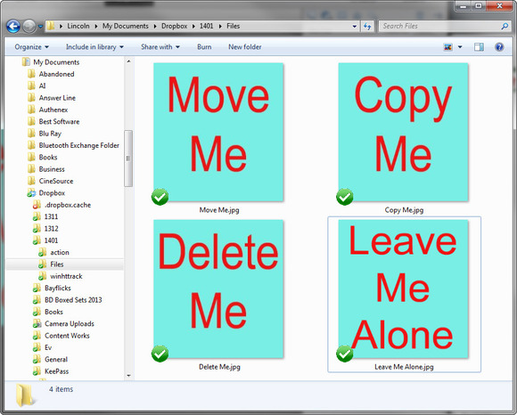
Common File/Folder Operations

Slide 30
Common File Operations
Common Folder Operations
Create
Copy
Move
Rename
Delete
Send to Recycling bin
Navigate to
Create
Copy
Move
Rename
Delete
Send to Recycling bin

Slide 31

Visual Studio demo and activity

Slide 32
Notes
What follows will not be on the quiz but it is worth your attention. It is here to provide more background and depth to today's topics.

Slide 33
What is a Character?
A character is usually considered to be anything you can type on a keyboard. Technically, a character is a byte with an ASCII value. "ASCII codes represent text in computers, telecommunications equipment, and other devices."
Each standard character requires one byte of storage in a file or in memory. (Double byte character sets exist for pictographic languages.)
Some examples: Aa Bb Cc … Zz, 0 – 9, !@#$%^&*()
Note that Tab [  ] Space [ ] and Enter/Return [  ] are also characters!
Notes:
https://en.wikipedia.org/wiki/ASCII
https://en.wikipedia.org/wiki/DBCS

Slide 34
What are Reserved Characters?
Operating Systems have reserved characters for filenames and command line inputs. Characters you might use in simple text, such as a question mark, have other meanings or functions when interacting with the OS.
Do not use these characters in file or directory names: / \ ? % * : | " ' < > [ ] { } ( )
The use of a space character in a filename is legal but not recommended. To separate words within a filename, use a – (dash) or _ (underscore) or CamelCase.
Notes:
https://en.wikipedia.org/wiki/Filename#Reserved_characters_and_words

Slide 35
More About Directory Structures
In Windows, the \ back-slash is a folder name separator.
In *nix, the / forward-slash is a directory name separator. *nix refers to both Linux and Unix.
./ and ../ have special meanings in folder & directory structures
./ refers to the current directory
../ refers to the parent directory

Slide 36
Absolute and Relative Paths
We are in one location within a file system at a time, that is the current directory
By default, any operations executed by the OS will occur within the current directory.

Slide 37
Absolute and Relative Paths
The absolute path is consistent from the root.
week1_notes.docx is in the absolute path C:\Courses\CPR101\
The absolute path is independent of the current directory.

Slide 38
Absolute and Relative Paths (Cont’d)
The relative path depends on the current .\ and parent ..\ directories.
relative to .\IPC144 week1_notes.docx is in ..\CPR101\

Slide 39
Wildcards
In file operations, we may want to access or work with multiple, similarly named files, or with files where we do not know the full filename.
Use wildcards to help with this: ? matches any single character * matches zero or more characters
gloss* matches Glossary.txt, Glossary.doc, Glossy.doc
gloss*.doc matches Glossary.doc and Glossy.doc
gloss?.doc matches Glossy.doc but not Glossary.doc.
Notes:
https://technet.microsoft.com/en-us/library/bb490639.aspx
http://www.linfo.org/wildcard.html

Slide 40
Wildcards (Cont’d)
From .\CPR101\ which files are matched by
week*.docx
week2_screenshot?.jpg
week*.doc*
*.*

Slide 41
File Attributes in Windows
File Attributes (archive, hidden, read-only, system, compressed) tell the OS how to handle the file.
Attributes can be set on or off.
To check or set the attributes of a file or directory in File Explorer, right click the item and select Properties.
read-only on means the file cannot be changed
archive: OS sets this attribute on when a file is changed. Backup software must set this attribute off upon a successful backup.

